Slide 1
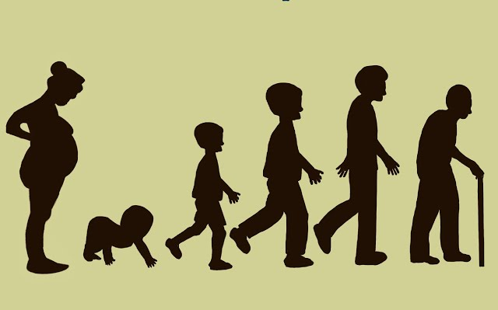
Human Growth and Development
T/618/4169 – Task 1 Presentation

Slide 2
Introduction
Human development occurs in six distinct, interdependent life stage categories.
1
Each stage features unique physical, intellectual, emotional, social milestones.
2
Understanding these stages supports effective, age-appropriate care and intervention.
3
Notes:
This presentation covers Task 1 of the assessment, outlining each life stage and summarising key developmental milestones across domains.

Slide 3
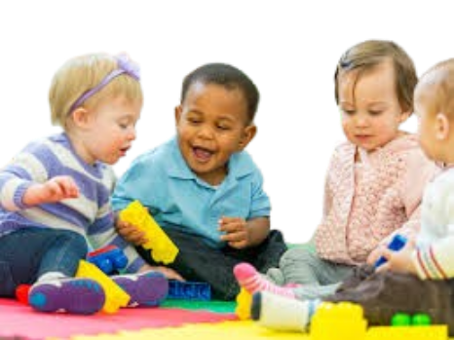
Infancy (0–2 years)
Rapid physical growth
Motor skills emerge
Sensorimotor learning.
Emotional bonding through attachment.
Notes:
Infancy (0–2 years) involves key developments across all domains. This slide highlights the main changes typically experienced during this life phase.

Slide 4

Childhood (3–12 years)
Motor refinement.
Logical thinking begins.
Peer interaction.
Emotional regulation improves.
Notes:
Childhood (3–12 years) involves key developments across all domains. This slide highlights the main changes typically experienced during this life phase.

Slide 5

Adolescence (13–18 years)
Puberty changes.
Abstract thinking.
Identity formation.
Strong peer influence.
Notes:
Adolescence (13–18 years) involves key developments across all domains. This slide highlights the main changes typically experienced during this life phase.

Slide 6

Early Adulthood (19–40 years)
Peak physical health.
Postformal thought.
Intimacy and independence develop.
Notes:
Early Adulthood (19–40 years) involves key developments across all domains. This slide highlights the main changes typically experienced during this life phase.

Slide 7

Middle Adulthood (41–65 years)
Gradual decline begins.
Career and family focus.
Generativity emerges.
Notes:
Middle Adulthood (41–65 years) involves key developments across all domains. This slide highlights the main changes typically experienced during this life phase.

Slide 8

Late Adulthood (65+ years)
Physical decline.
Chronic illness.
Emotional maturity.
Reflective thinking and integrity.
Notes:
Late Adulthood (65+ years) involves key developments across all domains. This slide highlights the main changes typically experienced during this life phase.

Slide 9
Milestone Comparison
Life Stage | Physical | Intellectual | Emotional | Social
Infancy | Crawling, walking, grasping | Sensorimotor, object permanence | Attachment, basic emotions | Smiles, imitation
Childhood | Running, writing, coordination | Symbolic play, logic (Piaget) | Self-regulation, pride/guilt | Friendships, cooperation
Adolescence | Puberty, brain maturation | Abstract/moral reasoning | Identity search, mood swings | Peer influence, dating
Early Adulthood | Peak fitness, slow decline | Postformal thinking, career skills | Intimacy, emotional stability | Independence, networking
Middle Adulthood | Menopause, bone decline | Expertise, slower fluid skills | Generativity, reflection | Caregiving, community roles
Late Adulthood | Mobility loss, chronic illness | Stable knowledge, slower speed | Life review, emotional maturity | Close relationships, retirement
Notes:
This table helps visualise how physical, intellectual, emotional, and social milestones progress and change across the six life stages.

Slide 10

Life stages represent a continuum of development shaped by nature and nurture.
Understanding these helps tailor health and care support.
Notes:
We’ve now reviewed all life stages and how they affect development. This knowledge supports personalised and age-appropriate health and social care.

